Slide 1
Distance and Length
Topic: Distance and Length
EQ: How can we apply our knowledge of scale ratios to figure out real life distances?

Slide 2
Topic: Distance and Length EQ: How can we apply our knowledge of scale ratios to figure out real life distances?
Learning Objectives:
Understand what a scale tells you
Able to produce a scale drawing
Able to use a scale to read a map

Slide 3
Starter
Write down as many examples as you can where we would use a scale

Slide 4
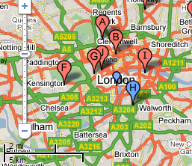

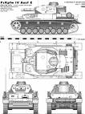
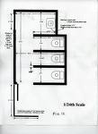
What are scale drawings?
Scale drawings are everywhere!
Scale Drawings
Vehicle design
On Maps
Footprints of houses

Slide 5
Topic: Distance and Length EQ: How can we apply our knowledge of scale ratios to figure out real life distances?
Scale drawing allows us to draw large objects on a smaller scale while keeping them accurate.
All scale drawings must have a scale written on them. Scales are usually expressed as ratios (which we just learned about!).
Example: 1cm : 100cm
The ratio 1cm:100cm means that for every 1cm on the scale drawing the length will be 100cm in real life

Slide 6
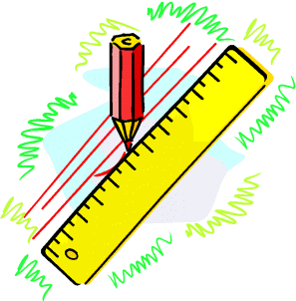
Topic: Distance and Length EQ: How can we apply our knowledge of scale ratios to figure out real life distances?
Example:
A scale of
1 cm = 2m
…means for every 1cm measured on a
drawing this represents 2m in real-life.

Slide 7
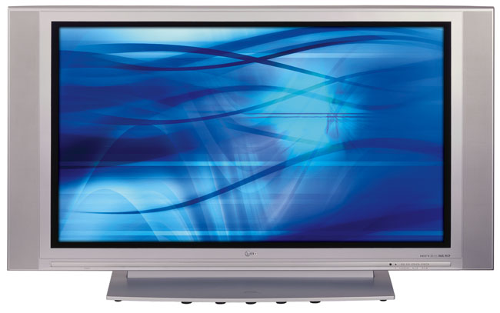
Topic: Distance and Length EQ: How can we apply our knowledge of scale ratios to figure out real life distances?
4x25= 100cm
4cm
2cm
2x25 = 50cm
The scale of this drawing is 1cm = 25cm
What is the actual width and height of the TV ?

Slide 8
Scale Drawings
Using a scale of 1cm : 9m draw a second right angled triangle in your books with side lengths in meters according to the scale.
5cm
45m
3cm
27m
4cm
36m

Slide 9
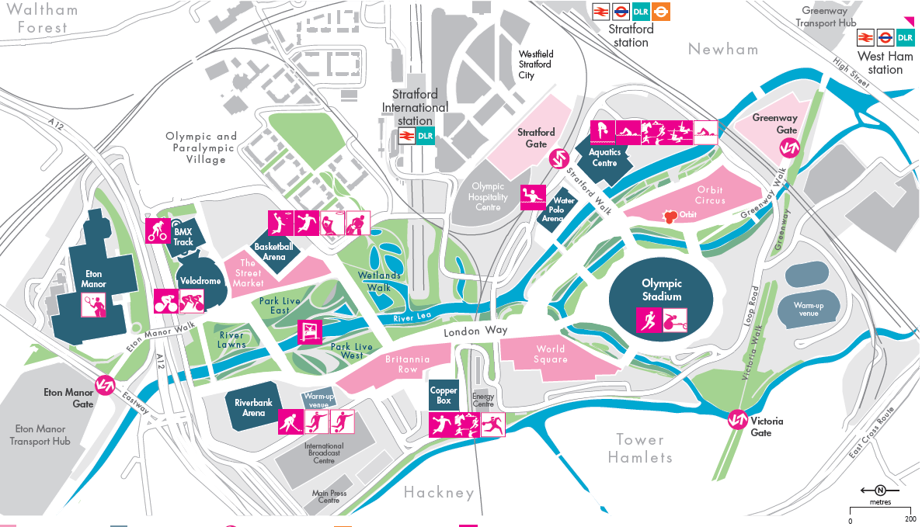

Slide 10
Map Reading
How far is the Olympic Stadium from the Aquatics center?
How far do you have to walk from Stratford International station to the Copper Box for the Handball event?
What is the perimeter of the Water Polo arena?
Which entrance is closer to the Olympic stadium; the Greenway gate of the Victoria gate and by how much?

Slide 11
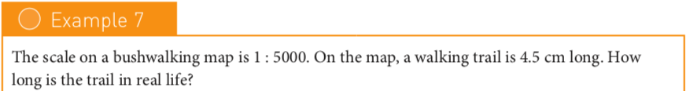
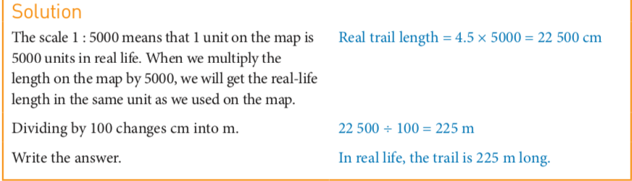
Topic: Distance and Length EQ: How can we apply our knowledge of scale ratios to figure out real life distances?

Slide 12
Map Scales Time Trial Worksheet

